Slide 1
Open the Bakery on Manhattan, NY
Research Project

Slide 2
Make the market research to plan new openings
The recommendation is based on the currently existing venues in the neighborhoods which will determine the ‘profile’ of neighborhood
Along with the general profile it’s considered how well projected demand on bakeries is already satisfied with existing bakeries nearby
Useful for business owners and investors

Slide 3
Data acquisition and cleaning
The list of New York neighborhoods with respective geographical coordinates.
Foursquare’s venues listings with information about places’ coordinates and categories. This will allow to identify the relation of places to neighborhoods and analyze the profile of each neighborhood in terms of what places are typically located there.
Foursquare’s categories dictionary which defines the tree-structure of all available place categories on Foursquare. This will allow to apply some grouping over places list to have comparable categories over different neighborhoods.
Geopy to find the NY geographical location for map drawing.

Slide 4
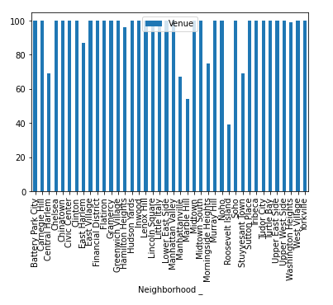
Data availability
Up to 100 venues per neighborhood were analyzed

Slide 5
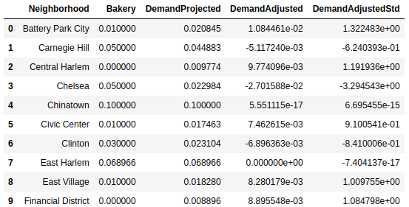
Demand evaluation
Demand was evaluated based on the formula: ‘Demand Adjusted’ = ‘Demand Projected’ – ‘Actual availability’

Slide 6
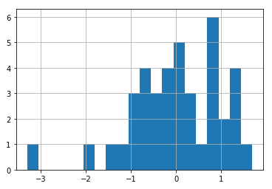
Demand Histogram
Let’s review the distribution over neighborhoods with histogram. Values are standardized.

Slide 7
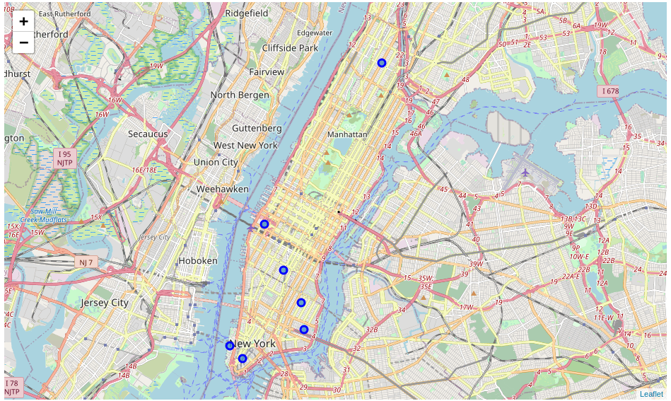
Suggested locations for a new Bakery on the map

Slide 8
Conclusion and future directions
Built a solution capable to provide recommendations for a location to open a new place
Consider other approaches of splitting the geographical area (ZIP codes, honeycomb split)
Consider making an application to provide interactive interface to user

